Slide 1
System and Network Administration
Shell, Pipes, Redirection

Slide 2


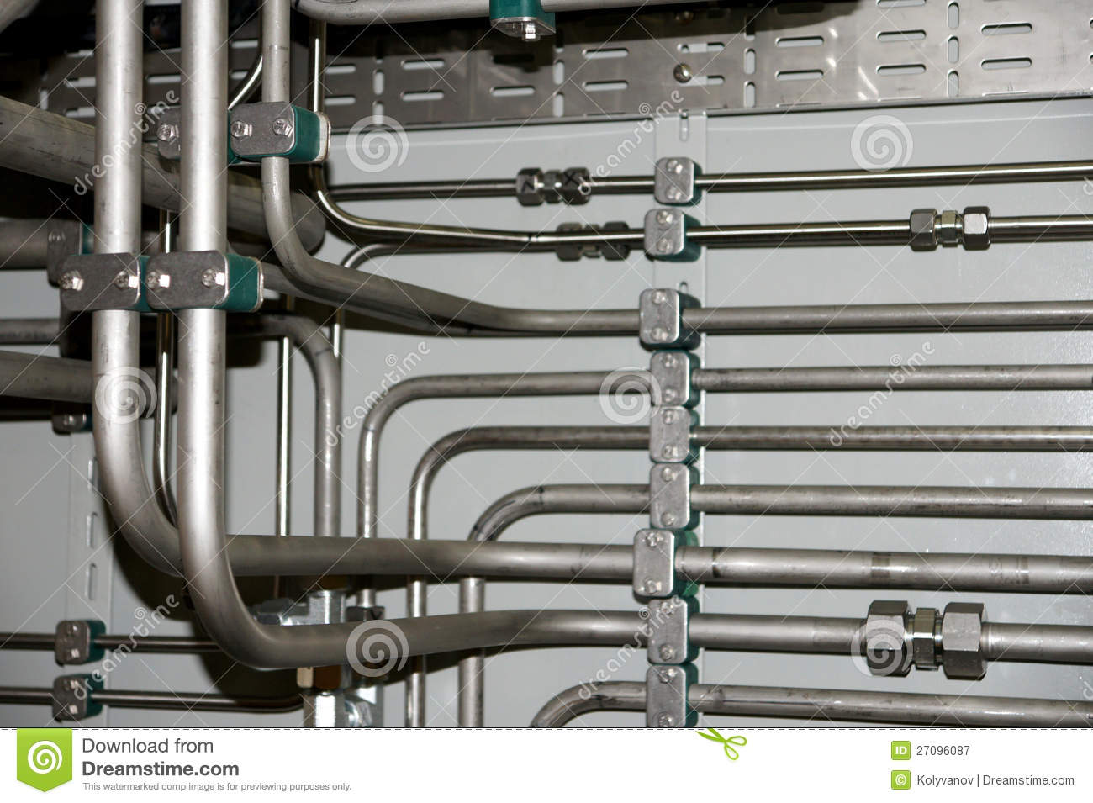

Shell, Pipes, Redirection

Slide 3
Theory and Practice
Standard I/O::Redirection
Standard I/O::Script I/O
Standard I/O::Netcat
System Administration::Multitail
Host Management::Prompt Color
Standard I/O::ASCII Art

Slide 4
Core Concepts
A process is the basic unit of activity for the operating system
A file is an object that a process can read from and/or write to
Every device in the system is represented by a file - even memory is a file.
The command line is a process known as the shell

Slide 5
Process Environment
Chains of processes share an environment
Environment is inherited by new processes.
changes made in local environment are not returned back to parent process environment.
Environment Variables
text strings
usually set by user or script
this is how command parameters are passed from parent to child.
Notes:
Environment variables make it easy to control program behavior
It all depends on what the processes start off with, inherited from parents
Try “set” in a Unix shell to see env vars

Slide 6
stdin, stdout, stderr
File descriptors are numbers that index a per-process data structure in the kernel that records which I/O channels (file, device, socket, pipe) a process has open. Each I/O system call (read, write, etc.) takes a file descriptor that indicates which channel the call should operate on.
By convention, the first entry in the table has index 0 and is called standard input (stdin), 1 is the standard output (stdout) and 2 is the standard error (stderr) channel.

Slide 7
Shell, Pipes, Redirection
When you work from the command line, the shell expects to be getting its input (STDIN) from the keyboard and showing the normal output (STDOUT) and any error messages (STDERR) on the terminal screen.
The shell allows you to set up connections between these file descriptors and specific files, devices, or pipes to other processes
Some of the possible manipulations are rather clever; the implementation that makes it possible is also rather clever.

Slide 8
Pipe
Perhaps the most commonly used character is | is referred to as "pipe".
This enables you to pass the output of one command through as the input to another.
Essentially, the shell redirects the left side command's stdout to the right side command's stdin
This connection applies only to these particular processes, and lasts only as long as the processes run

Slide 9
Pipe
So, for example, if we run the command
ls -l | more
the output (stdout) of the ls command will be "piped through more". In detail, this command tells the shell to
1. create a process for ls
2. create a process for more
3. connect ls stdout (FD1) to more stdin (FD0)

Slide 10
Redirect
The other characters that are used quite often are
< to redirect stdin and
> or >> to redirect stdout.
Redirecting stdout to a file is very common, for example the command ls /bin > myfile
create a process for ls
point ls stdout (FD1) to a file in the current directory named myfile
> will create a new file every time >> will add to the end of an existing file, or create a new one

Slide 11
ANSI Escape Codes
ANSI escape sequences are non-printed text that is interpreted to change the format of some text.
Their support depends on the terminal, but the color control sequences are commonly supported
echo -e "\e[01;32m"; $(date +%R); echo -e "\e[00m"
The -e option of the echo command enables parsing of the escape sequences. Check Quick Reference :: Escape Codes on the menu for a list of possibilities.
The ; is the way we string together multiple independent commands on a single command line

Slide 12
Variable $ubstitution
Echo the STRING(s) to standard output.
-n do not output the trailing newline
-e enable interpretation of backslash escapes
Positional Parameters are provided on the command line
$0 is the name of the command itself
$(command) uses the output of the command
(stdout is saved as a variable
READ is used to parse stdin into variables
(used with pipe)

Slide 13

Shell, Pipes, Redirection
Pipe to a program
ls /usr/share/figlet/ | grep .*lf
Redirect to a file
ls /usr/share/figlet/ > fileToCreate
ls /usr/share/figlet/ >> fileForAppend
Command substitution
figlet $(date +%A)
Variable substitution with redirect to a program
while read line; do
printf '%s\n' "$line"
done < "${1:-/dev/stdin}"
bash shell

Slide 14
#!/bin/bash
echo "Read from stdin"
read HOST PORT FILE therest
echo -n -e "\e[01:32m"; echo -n $HOST; echo -e "\e[00m"
echo -n -e "\e[01:31m"; echo -n $PORT; echo -e "\e[00m"
echo -n -e "\e[01:34m"; echo -n $FILE; echo -e "\e[00m"
echo "anything else: $therest"
echo
echo "$0 command line positional parameters"
echo -n -e "\e[01:32m"; echo -n $1; echo -e "\e[00m"
echo -n -e "\e[01:31m"; echo -n $2; echo -e "\e[00m"
echo -n -e "\e[01:34m"; echo -n $3; echo -e "\e[00m"
echo
# suggestions:
# echo "$(date +%A) $(date +%x) $(date +%R)" |./ptxt 1 2 3 4
# echo "1 2 3 4" |./ptxt $(date +%A) $(date +%x) $(date +%R)

Slide 15
Shell, Pipes, Redirection
Send command stdout |to command stdin (pipe)
Send command stdout >to new file
Send command stdout >>to end of existing file (append)
varname="value"
varname="$(command_stdout)"
echo "$varname" == stdout: value of variable
echo '$varname' == stdout: $varname (literal string)
SO:
echo '#!/bin/bash' >filename.sh
echo 'fortune |fold -s -w 70 |boxes -d columns' >>filename.sh == magic abracadabra is first line of file
== piped command is second line of file
chmod 755 filename.sh
./filename.sh

Slide 16
Named Pipe
Technically, a Unix "named pipe" is a First In First Out (FIFO) interproccess communication mechanism.
In contrast to "unnamed pipes" (represented by | between two commands) a named pipe appears as a special file in the filesystem, which can be accessed by independent processes.

Slide 17
Named Pipe
Using a named pipe is straightforward, just write something to it in one process and read from it in another.
Data written to the named pipe will be stored until another process reads from the pipe.
The first process will exit when it's done writing and sends EOF, and the second process stops when it sees the EOF and exits.

Slide 18




